Slide 1



Slide 2


Slide 3

CSS
CSS stands for “Cascading Style Sheets”
A style language that defines how an html document is displayed.
HTML defines the structure of the page, CSS defines how elements are displayed.

Slide 4
What can i do with CSS…..
Change font color, size, family
Change background colors and images
Specify the width and height of a block element
Add margins, borders and padding

Slide 5

History of CSS
CSS1 (1996) enabled users to set font size; align text center, left, or right; set body margins; and apply background and foreground colors to page elements.
CSS2 (1998) included features such as design styles for different output devices such as print media and aural devices, and controlling the appearance and behavior of browser features.
CSS3 (2005) includes text effects such as drop shadows and Web fonts, semitransparent colors, box outlines, and rotating page elements

Slide 6
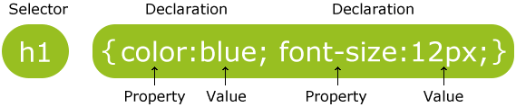
CSS Syntax
A CSS comprises of style rules that are interpreted by the browser and then applied to the corresponding elements in document
selector { property: value }
Ex:

Slide 7
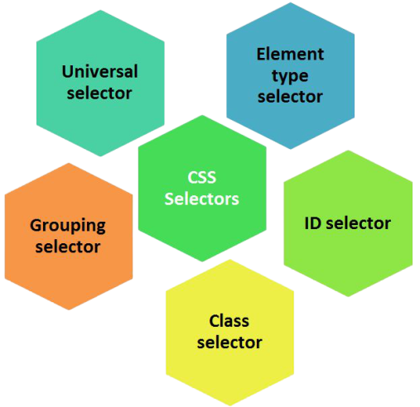
CSS Selectors
CSS selectors are used to "find" (or select) HTML elements based on their element name, id, class, attribute, and more.

Slide 8
element selector
The element selector selects elements based on the element name.
You can select all <p> elements on a page like this :
p { text-align: center; color: red; }

Slide 9
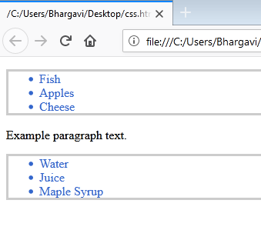
<html>
<body>
<head>
<style>
ul {
color: #36C;
border: solid 3px #ccc;
}
</style>
</head>
<ul>
<li>Fish</li>
<li>Apples</li>
<li>Cheese</li>
</ul>
<p>Example paragraph text.</p>
<ul>
<li>Water</li>
<li>Juice</li>
<li>Maple Syrup</li>
</ul>
</body>
</html>

Slide 10
The id Selector
The id selector uses the id attribute of an HTML element to select a specific element.
The id of an element should be unique within a page, so the id selector is used to select one unique element!
To select an element with a specific id, write a hash (#) character, followed by the id of the element.
#para1 { text-align: center; color: red; }

Slide 11
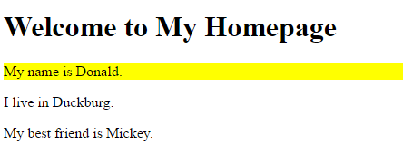
<html>
<head>
<style>
#firstname {
background-color: yellow;
}
</style>
</head>
<body>
<h1>Welcome to My Homepage</h1>
<p id="firstname">My name is Donald.</p>
<p id="hometown">I live in Duckburg.</p>
<p>My best friend is Mickey.</p>
</body>
</html>

Slide 12
The Universal Selectors
Rather than selecting elements of a specific type, the universal selector quite simply matches the name of any element type
The universal selector works like a wild card character, selecting all elements on a page
* { color: green;
font-size: 20px;
line-height: 25px;
}

Slide 13
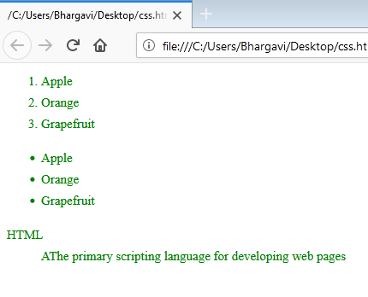
<html> <HEAD>
<style>
* {
color: green;
font-size: 20px;
line-height: 25px;
}
</style>
<body>
<ol type="1">
<li>Apple</li>
<li>Orange</li>
<li>Grapefruit</li>
</ol>
<ul type="disc">
<li>Apple</li>
<li>Orange</li>
<li>Grapefruit</li>
</ul>
<dl>
<dt>HTML</dt>
<dd>AThe primary scripting language for developing web pages </dd>
</dl></body></html>

Slide 14

The class Selector
The class selector selects elements with a specific class attribute.
To select elements with a specific class, write a period (.) character, followed by the name of the class.
In the example below, all HTML elements with class="center" will be red and center-aligned:
.center { text-align: center; color: red; }

Slide 15
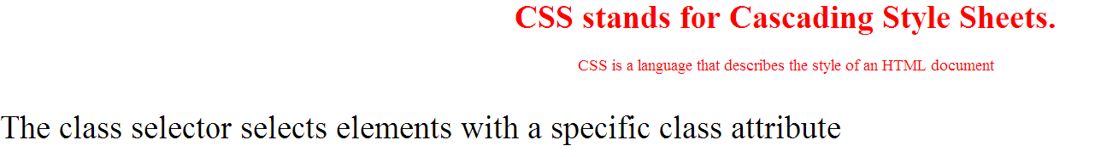
<html><head>
<style>
p.center {
text-align: center;
color: red;
}
p.centerlarge {
font-size: 100%;
}
</style></head>
<body>
<h1 class="center">CSS stands for Cascading Style Sheets.</h1>
<p class="center"> CSS is a language that describes the style of an HTML document </p>
<p class="centerlarge"> The class selector selects elements with a specific class attribute </p>
</body>

Slide 16
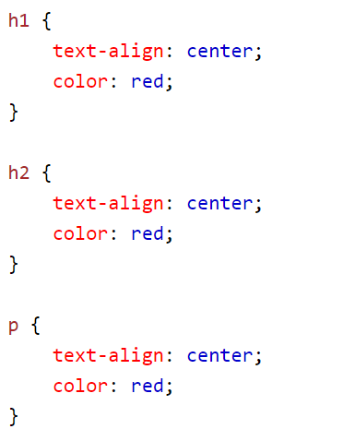
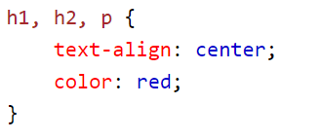
Grouping Selectors
If you have elements with the same style definitions, like this:
It will be better to group the selectors, to minimize the code.
To group selectors, separate each selector with a comma.

Slide 17
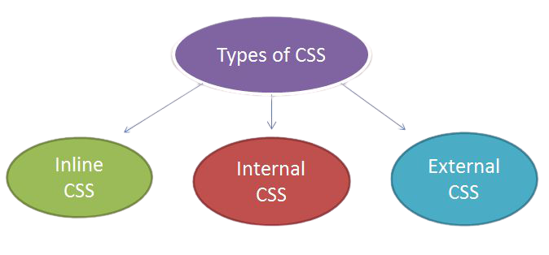
Three Ways to Insert CSS
There are three ways of inserting a style sheet:

Slide 18
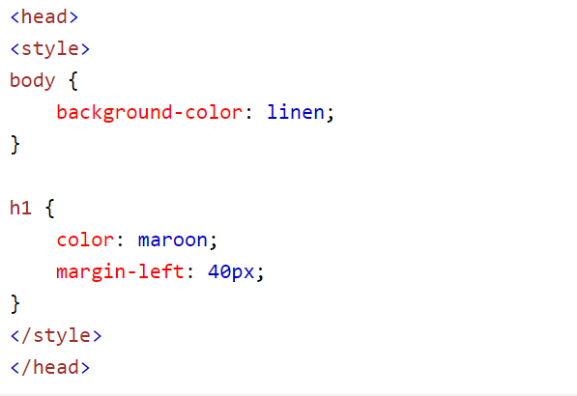
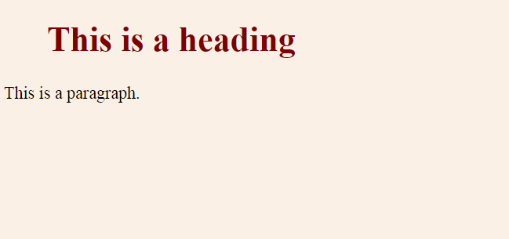
Internal Style Sheet
In this CSS rules are defined with in the document itself using style tag.
Internal styles are defined within the <style> element, inside the <head> section of an HTML page:
An internal style sheet may be used if one single page has a unique style.

Slide 19

Example for Internal Style sheet
<html>
<head>
<title>Cascading Style Sheet</title>
<style>
h2 {
font-family : Tahoma;
color: blue;
text-align: center;
text-transform : uppercase;
}</style>
</head>
<body>
<h2> Hi guys how r u</h2>
</body></html>

Slide 20
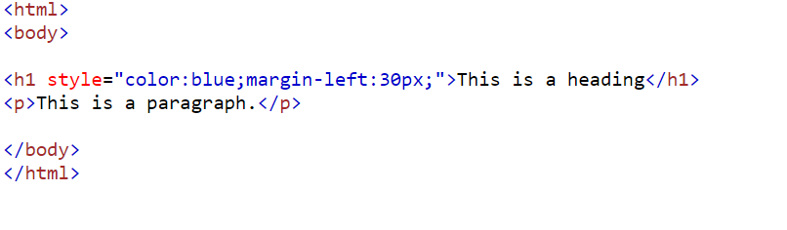
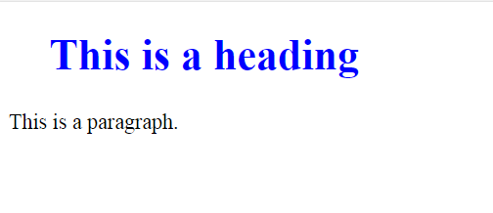
Inline Styles
An inline style may be used to apply a unique style for a single element.
To use inline styles, add the style attribute to the relevant element. The style attribute can contain any CSS property.
The example below shows how to change the color and the left margin of a <h1> element:

Slide 21

External Style Sheet
An external style sheet is a separate text file with .css extension.
You define all the Style rules within this text file and then you can include this file in any HTML document using <link> element.
The <link> element can be used to include an external stylesheet file in your HTML document.
With an external style sheet, you can change the look of an entire website by changing just one file!

Slide 22
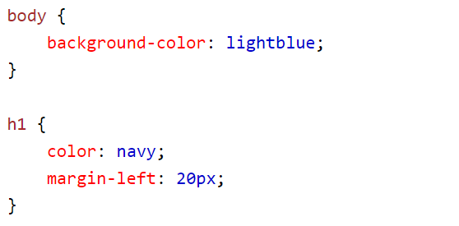

Cont…
An external style sheet can be written in any text editor. The file should not contain any html tags. The style sheet file must be saved with a .css extension.
Here is how the "mystyle.css" looks:

Slide 23
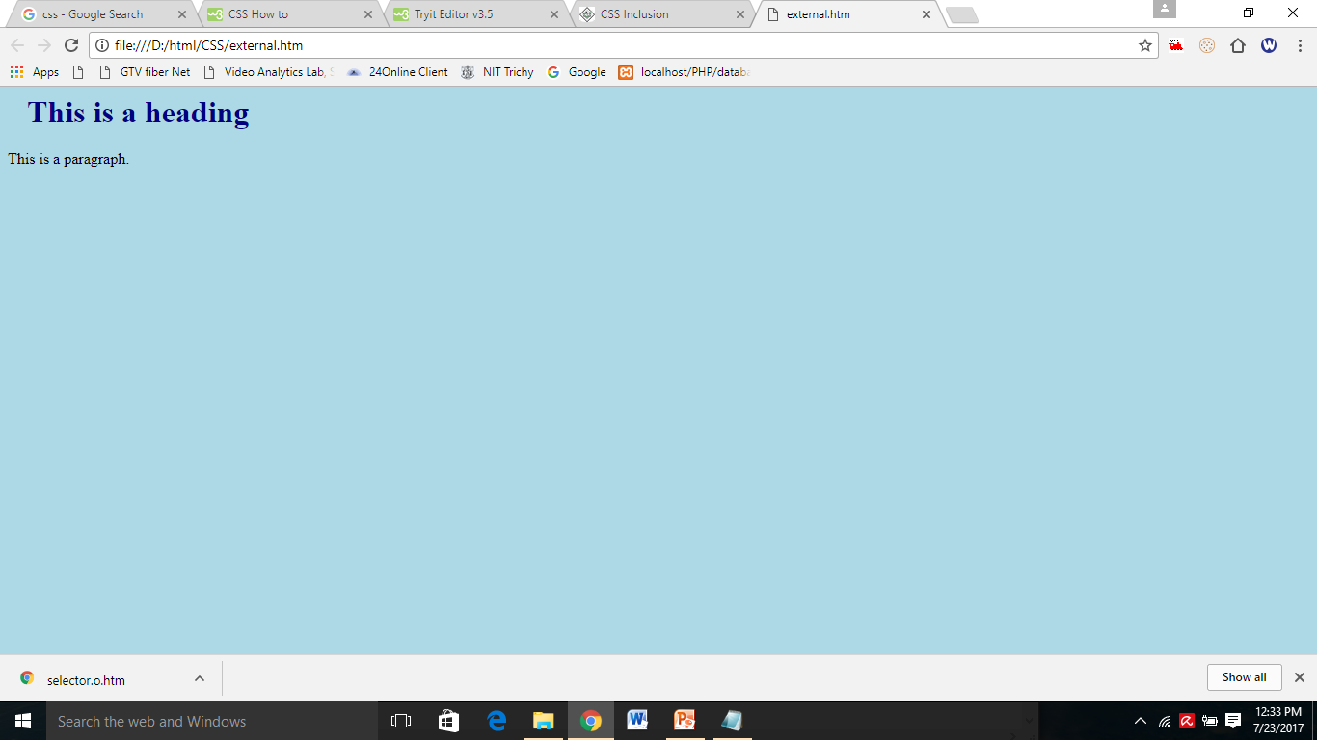
mystyle.css: body { background-color: lightblue; } h1 { color: navy; margin-left: 20px; }
<html><head>
<link rel="stylesheet" type="text/css" href="mystyle.css">
</head>
<body>
<h1>This is a heading</h1>
<p>This is a paragraph.</p>
</body></html>

Slide 24

CSS PROPERTIES
A CSS rule consists of a CSS selector and a set of CSS properties.
The CSS selector determines what HTML elements to target with the CSS rule.
The CSS properties specifies what to style of the targeted HTML elements.

Slide 25
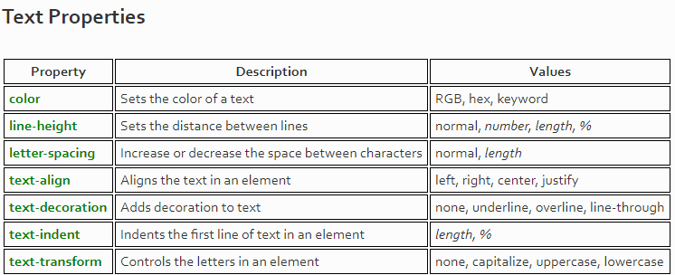

Slide 26
Note:The color property is used to set the color of the text. The color is specified by:
a color name - like "red"
a HEX value - like "#ff0000"
an RGB value - like "rgb(255,0,0)"

Slide 27
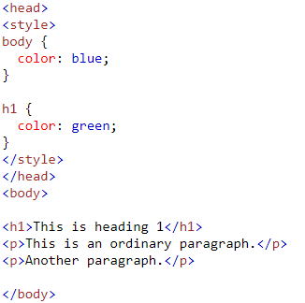
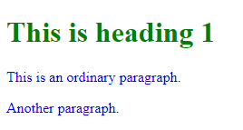

Slide 28
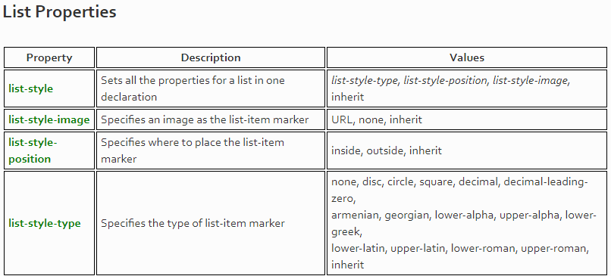

Slide 29
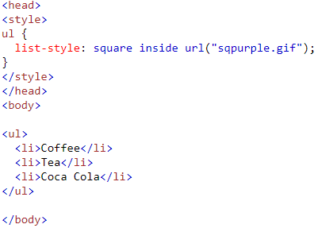


Slide 30
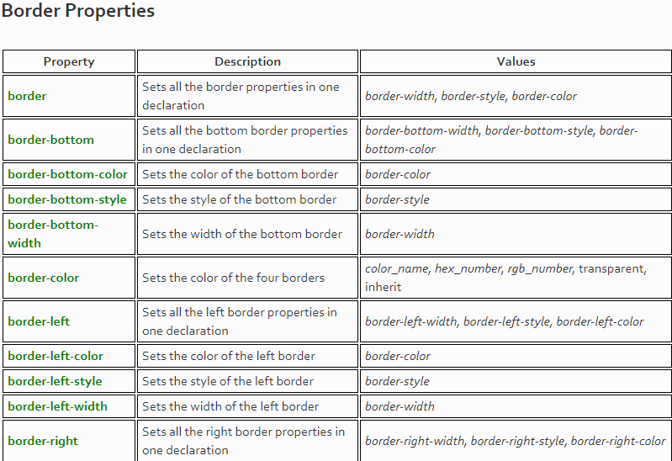

Slide 32
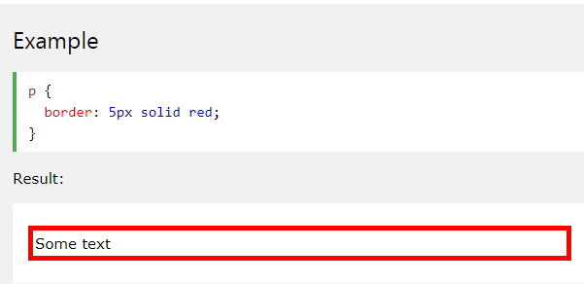
The border property is a shorthand property for the following individual border properties:
border-width
border-style (required)
border-color

Slide 33
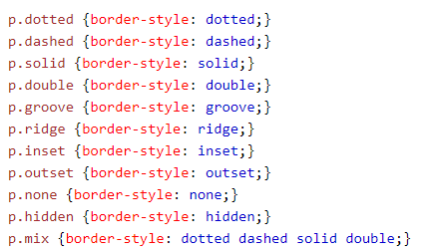
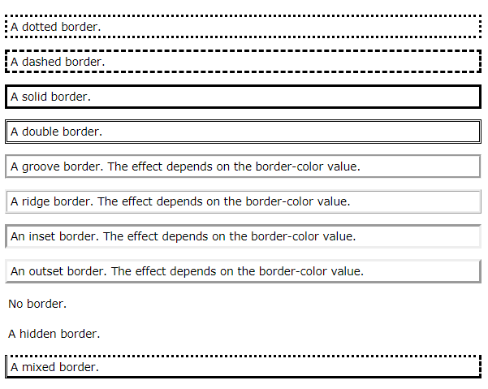
Border style
The border-style property sets the style of an element's four borders.
This property can have from one to four values

Slide 34
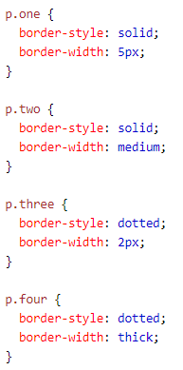
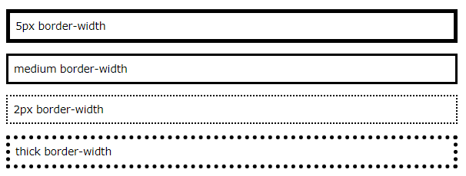
CSS Border Width
The border-width property specifies the width of the four borders

Slide 35
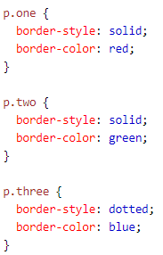
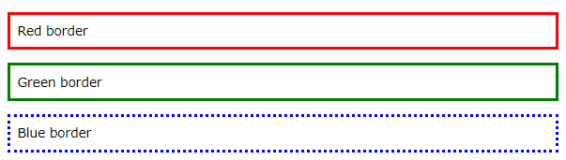
CSS Border Color
The border-color property is used to set the color of the four borders

Slide 36

Here are some basic CSS properties to work with.
Text Properties(https://www.w3schools.com/css/css_text.asp)
List Properties(https://www.w3schools.com/css/css_list.asp)
Border Properties(https://www.w3schools.com/css/css_border.asp)
Font Properties(https://www.w3schools.com/css/css_font.asp)
Background properties (https://www.w3schools.com/css/css_background.asp)

